Slide 1
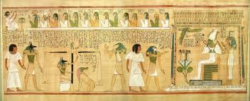
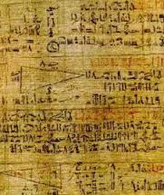
Lecture 2: Ancient Egypt
Dr. Driggers
History 1310
STUDENT VIEW

Slide 2
Objectives
Survey of science, medicine, and technology in Ancient Egypt
Begin our exploration of the three subjects, mentioned above, in world cultures
Briefly discuss “Time”

Slide 3
Opening vignette
“I had one to the Mining region of the sovereign
I had gone down to the sea
In a boat 120 cubits long
40 Cubits broad
In which there were 120 sailors from the choicest of Egypt…
Before it came they could foretell a gale,
A storm before it existed”
From A Tale of the Shipwrecked Sailor (Maybe from 2500 BC

Slide 4
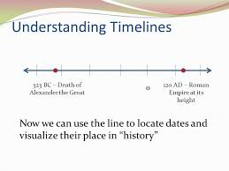
Thinking About Time

Slide 5
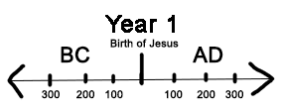
Religious Tradition Matters

Slide 6
Gregorian calendar
Introduced in 1582
Pope Gregory XIII
Modification of Julian Calendar
Julian Calendar introduced by Julius Cesar as a modification of the current Roman Calendar, after Roman conquered Egypt
365 Days, with a leap year every four years in February
10 Days were dropped to make the celebration of Easter (usually at the Vernal Equinox) with the historical time of celebration in the Early Christian Church
More accurate calculation for the leap year*

Slide 7
Religious traditions and time
For instance, it’s 5776 in the Jewish Tradition
Traditional Lunar-Solar Calendar (follows moon phases + solar year)
From their marking of creation
Does not mean that even Orthodox Jews think that the earth is only about 6,000 years old (not young earth creationist)
The current Islamic year is 1437 AH. (in the year of the Hijra)
Hijra (Mohammed flees from Mecca to Medina; run out by the political powers of the city)
Lunar Calendar—354 days
Starts the year 622 CE (Year of the Hijra)

Slide 8
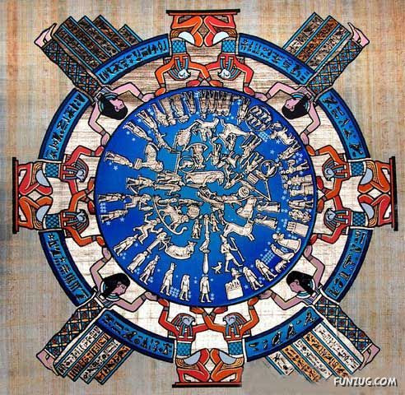
Egyptian Calendar

Slide 9
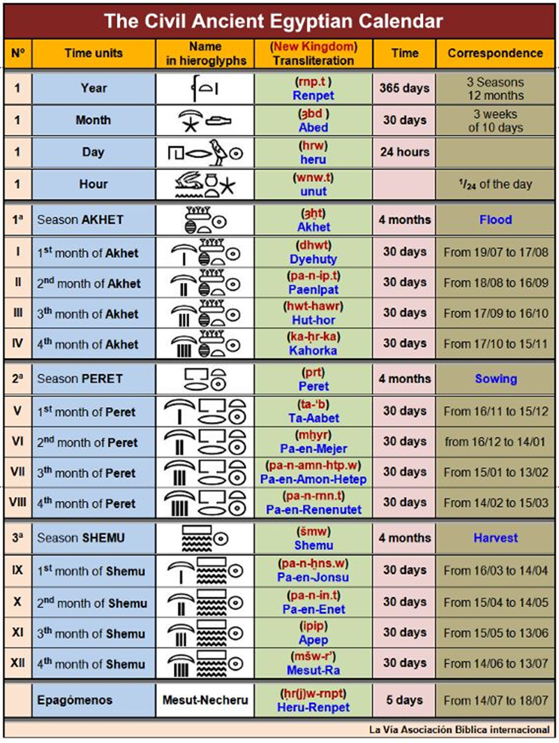
Followed Nile’s flooding Cycle
Usually occurred on the 19th day of July (Julian Calendar)
360 Days
Year divided up into agricultural seasons:
Flood
Sowing
Harvest

Slide 10
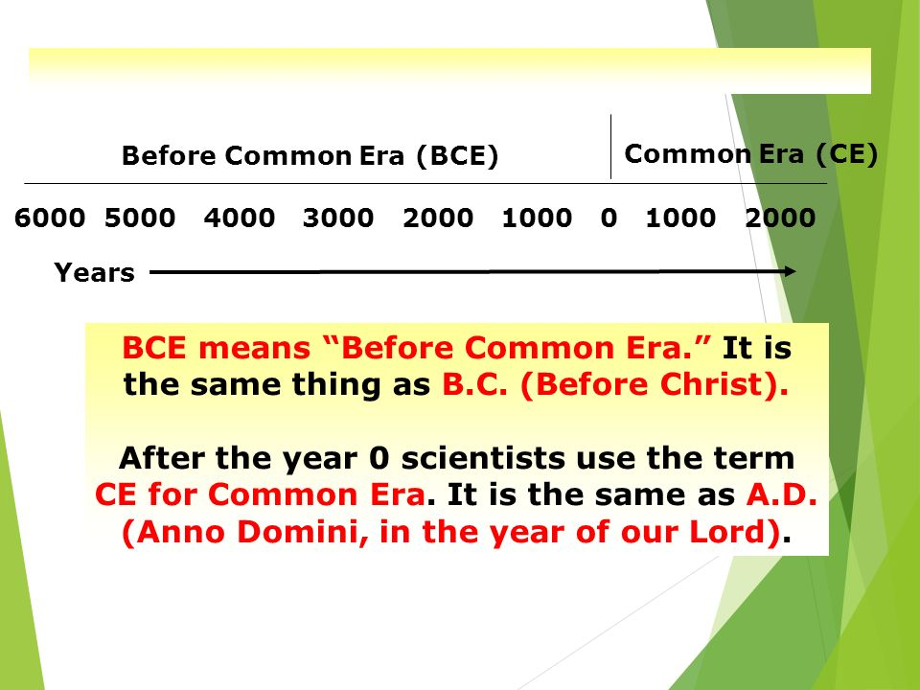
Common Era and After Common Era

Slide 11
Continuation of the discussion of the passage
What does this “Primary Source” tell us about Egyptian Society?
What’s a cubit?
Ships?
Knowledge that this primary source conveys?
What are the origins and basic information about Ancient Egypt?
How does this have a bearing on science and technological development?

Slide 12
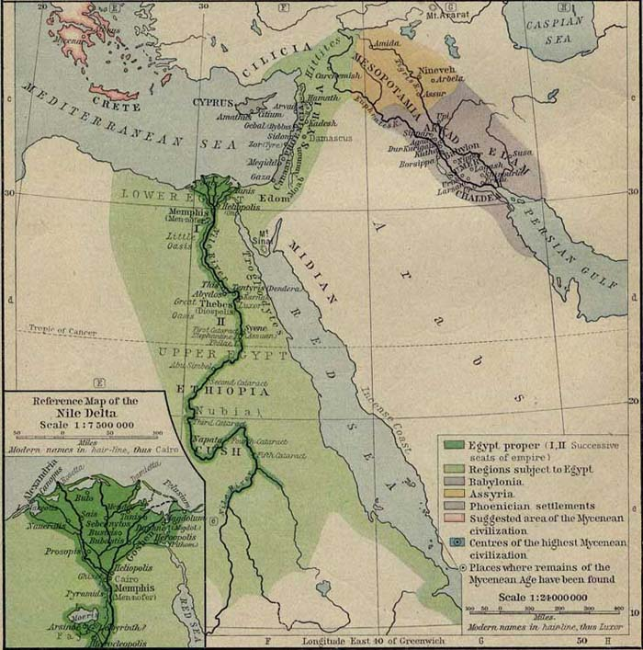
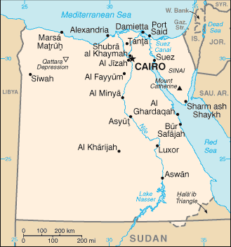
Background of Ancient Egypt

Slide 13
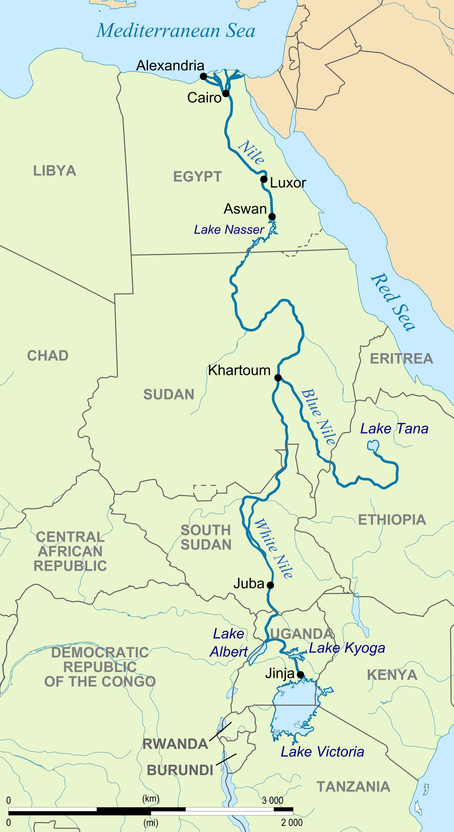
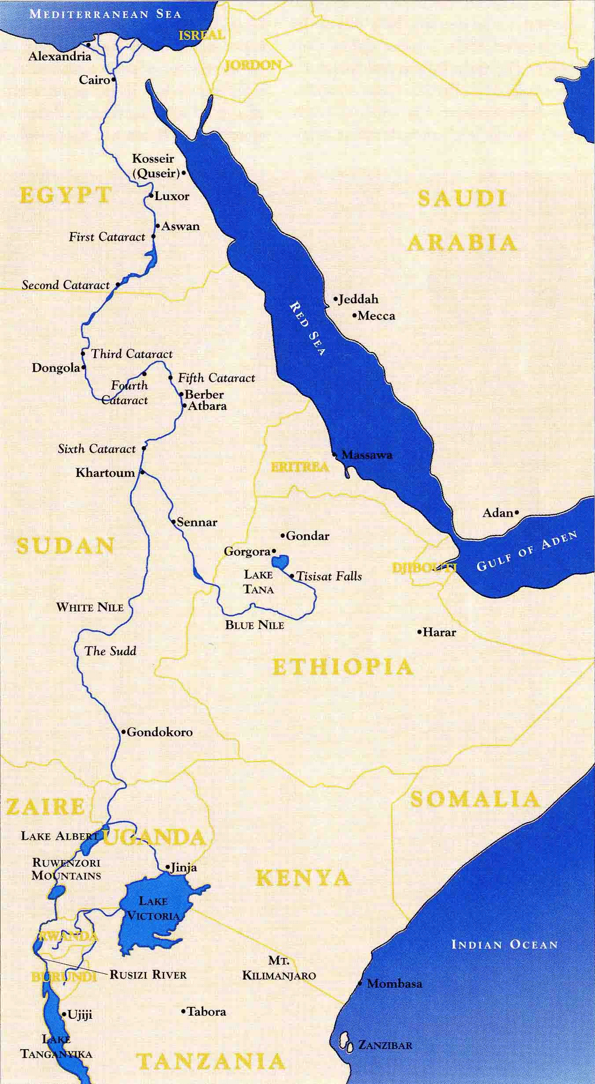
The Nile River (the lifeline of Egypt)

Slide 14
Discussion of the Nile
General Information/History about the Nile
Egypt's and its close relationship with the Nile
Religion and the Nile

Slide 15
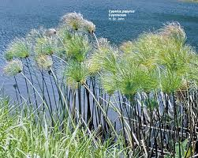
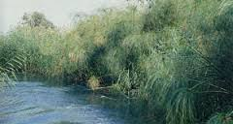
Advanced plant knowledge
The example of the Cyperus Papyrus

Slide 16
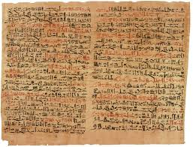
Papyrus (Edwin Smith papyrus pictured here)

Slide 17
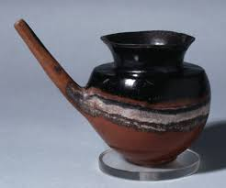
Agricultural successes'
What did Egyptians grow and eat?
And Drink?

Slide 18
Examples of foods
Beer (Barley and Emmer)
Wine (Grapes)Grains
Spices (garlic, aniseed, cinnamon, coriander, cumin, dill, fennel, marjoram, rosemary, and thyme (BUT NO PEPPER?)
Meats (Cattle, Quail, --hens raised for eggs MUCH later; ducks, geese)
Fish (Caught with net, spears, traps, and hooks)
Veggies (beans, cabbage, celery, chickpeas, peas, onions, lentils)
Fruits (apples, dates, figs, jujubes, olives, plums, pomegranates, melons)
Sweets/Sweetening Agents (Dates, fig, honey)

Slide 19
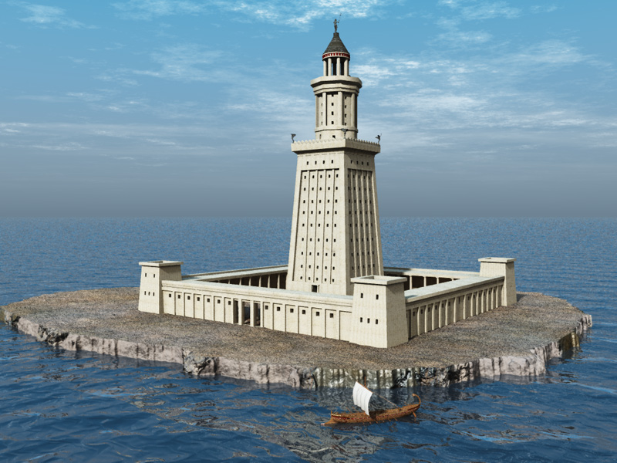
Egyptians and the sea

Slide 20
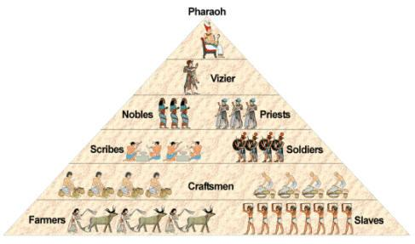
Egyptian civilization and society (organization)

Slide 21
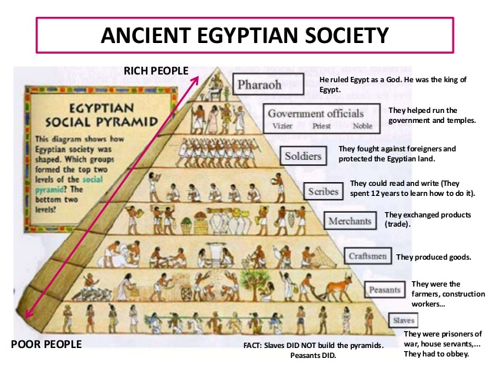

Slide 22
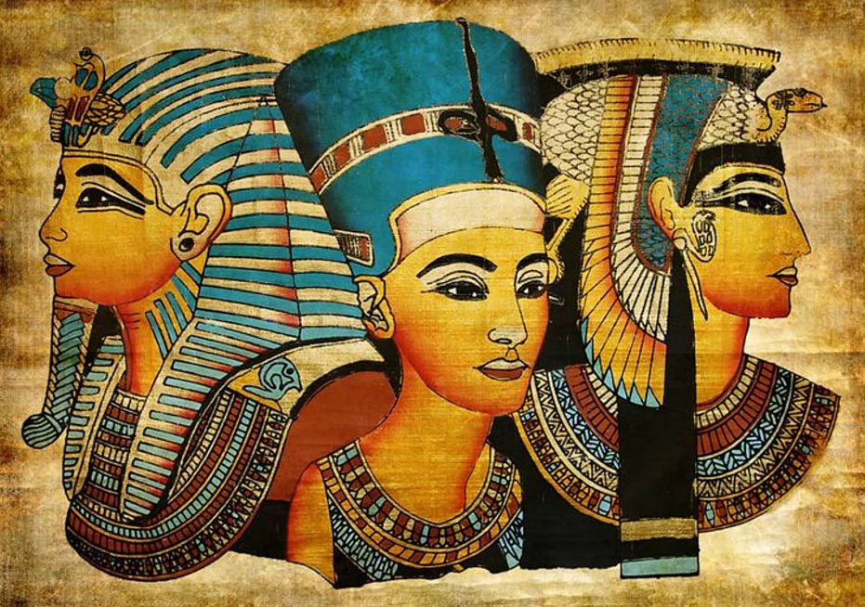
Pharaoh
Description of Pharaoh
Short discussion of the Expansion of Egyptian Power
Divine Rule

Slide 23
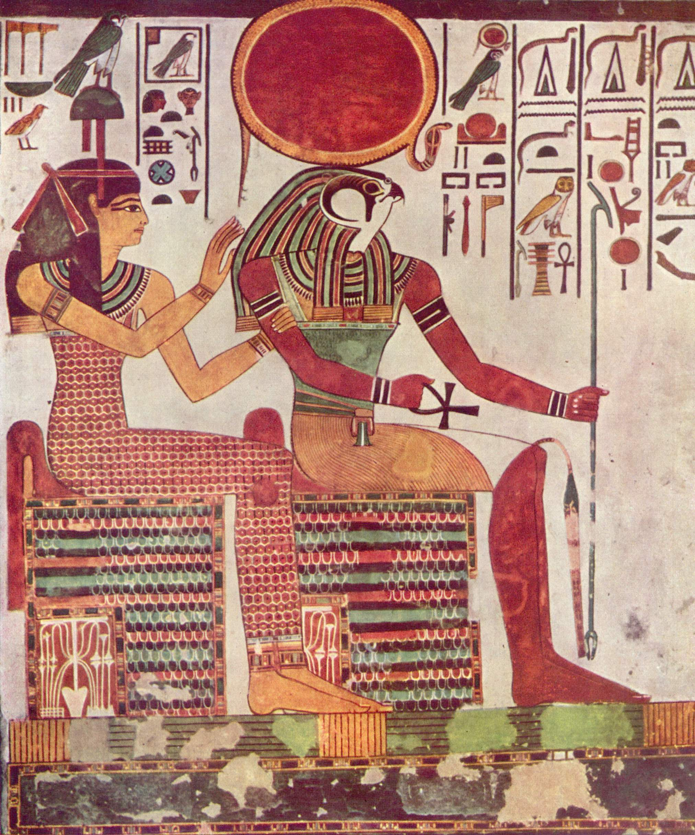
Religion (RA)

Slide 24
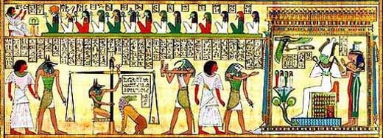
Religious tradition 2→ “Book of the Dead”

Slide 25
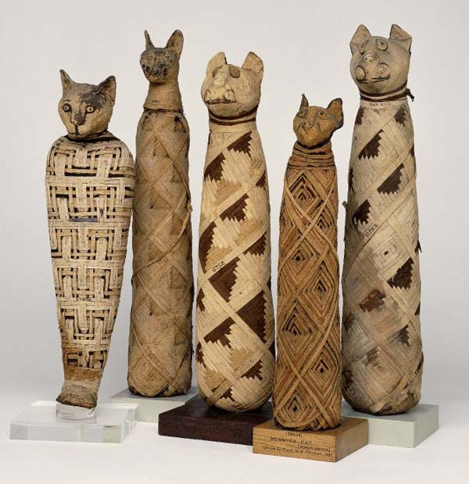
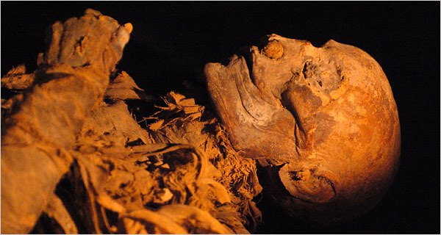
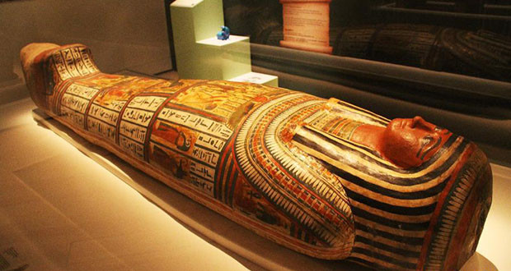
Mummification

Slide 26
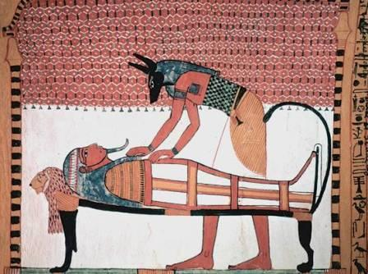
Discussion of the Steps of mummification

Slide 27
The Egyptians believed that if the pharaoh's body could be mummified after death the pharaoh would live forever. The tombs were designed to protect the buried Pharaoh's body and his belongings.
The reason they built the pyramids next to the Nile River was so it would be easier to get the blocks to the pyramid. The stones could be bought nearer to the pyramid building site by boat.
The Great Pyramid is the largest and most famous of the pyramids. It was built for the Pharaoh Khuf. It is over 140 metres high and took 20 years to build.

Slide 28
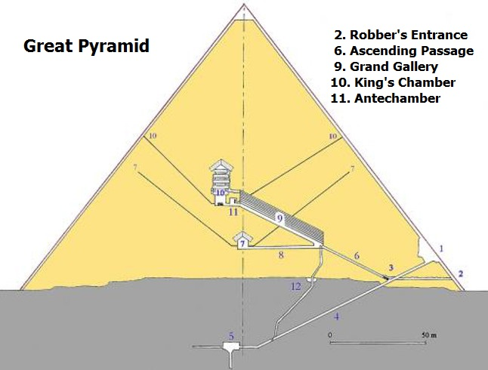
Pyramids 2

Slide 29
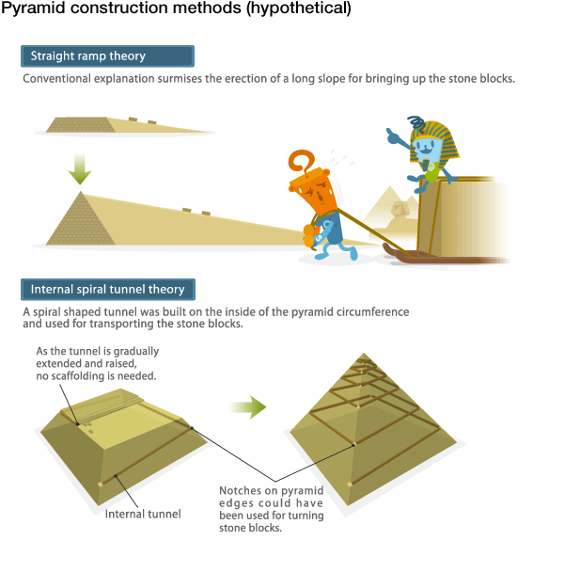
Archeologists still debating about the nature of their construction

Slide 30
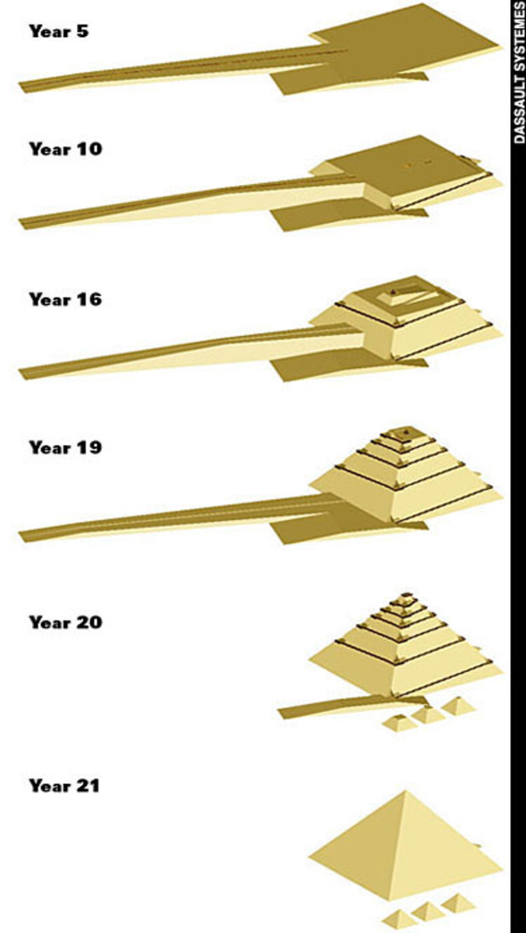
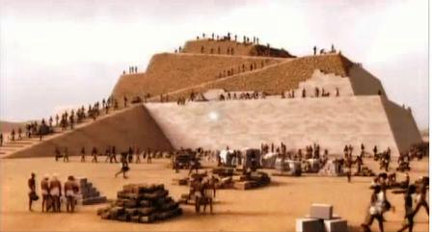

Slide 31
